Slide 1

Permission Impossible
Dead Reckoning Pain
Notes:
Thanks for coming to my talk “Permission Impossible Dead Reckoning Pain” today, where I will be telling you a story about a real life project that I had to do that became the inspiration for this talk

Slide 2



Notes:
So before I begin …. <Acknowledgement of Country”

Slide 3

Shameless Self-Plug
Francis Chung
Co-Organiser of Alt.Net and DDD-AU Meetups
30 years in the industry
My first computer was an Apple II
Am I an Apple Fanboi?
Notes:
… and you might be wondering “Am I an Apple Fanboi when I am clearly using a fake apple laptop to do this presentation” - I’ll let you make up your minds on that

Slide 4
Once upon a time ….
Notes:
If you’ve been in the industry for 30 years, all your stories starts with “Once upon a Time …” so …. “Once upon a time … “

Slide 5

Notes:
I worked as a Principal Engineer at FBs in far away city called Amsterdam. FreshBooks is an Accounting Platform, main market US/Canada, 1 million plus users worldwide

Slide 6
An Impossible Mission was given
Notes:
So sticking to the theme,, An Impossible Mission was given …

Slide 7
Introduce a new User Class The FIRM Accountant
Notes:
You might be wondering how is this an Impossible Mission? What in the world is a FIRM Accountant?

Slide 8

This handsome Accountant
with the firm grip?
Notes:
… and the firm stare ….

Slide 9

More like this guy with the Firm Accountant looks …
The world can be accrual sometimes
Notes:
Basically like an external Accountant or Auditor that shares some but not all access rights as your regular accountant. Apologies to any real accountants in the room. I’ll take any beatings in the corner after the Q&A session at the very end. So feel free to ask a million questions during the Q&A at the end.

Slide 10
The FIRM Accountant -
External Auditor, External Accountant
Notes:
You might be wondering how is this an Impossible Mission? What in the world is a FIRM Accountant?

Slide 11
Analysis
Notes:
Introducing a new user class? How hard can this be? So I did some analysis of the task at hand

Slide 12
Analysis
933 potential code changes spanning across 6 systems
Notes:
Hmm that;s a lot of changes …

Slide 13
Analysis
933 potential code changes spanning across 6 systems
Given 1 intern Developer for Project

Slide 14
Analysis
933 potential code changes spanning across 6 systems
Given 1 intern Developer as a resource
I wasn’t allowed to code (Too expensive they said)
Notes:
Or maybe they saw my code and thought that was far more expensive to fix

Slide 15
Analysis
933 potential code changes spanning across 6 systems
Given 1 intern Developer as a resource
I wasn’t allowed to code (Too expensive they said)
I had 2 months to deliver

Slide 16
Risks
Code Changes wasn’t the biggest challenge

Slide 17
Risks
Code Changes wasn’t the biggest challenge
First new user class in 5+ years
Notes:
… and we are talking about E2E Testing throughly

Slide 18
Risks
Code Changes wasn’t the biggest challenge
First new user class in 5+ years
Testing this however …
Notes:
… and we are talking about E2E Testing throughly

Slide 19
Your project / sanity will self destruct in ….
Notes:
<Hair Pulling Gesture> - A good representation of my brain at the time

Slide 20
Permission Impossible
Dead Reckoning Pain
Notes:
.. and hence … the Title of my talk today

Slide 21

Roughly Speaking …
Notes:
To fast forward 2.5 months later … like most IT Projects this one was late as well …

Slide 22

2 Months of Zoom Meetings
Notes:
2 Months of Begging on Zoom can do wonders to your project. So I was allowed to touch some code but more importantly, I was able to convince some teams to take ownership for the FIRM Accountant changes, otherwise I’ll have to do the changes myself

Slide 23
Project Delivered!
Notes:
I actually delivered the project, and I didn’t break production as the Las Vegas bookies predicted . Vegas is still pissed about losing money over that

Slide 24

On Reflection …
Notes:
So when I got a chance to lie down and reflect upon what I did, what I really should have done was …

Slide 25
What I should have done
Notes:
… is to jump out of the building and ran for my life and my sanity. The stress of delivering this project was pretty intense
FBs had new features on their roadmap that would require new User Classes and this exercise would be surely repeated.

Slide 26
Introduce a new User Class The SOFT Accountant
Notes:
“Hey Francis, we need a new SOFT accountant class”. And guess who’s doing this project again?

Slide 27
There has to be a better way !
Notes:
The fear of going SOFT got me acting and that’s going to be the basis of the next segment of my talk.

Slide 28
THE END - Part 1

Slide 29
Part 2 - Deeper Dive

Slide 30

Agenda
Permissions
Intro - AuthN vs Authz
Different Access Control Models
Code Examples
Q&A

Slide 31
Authentication (AuthN)
vs
Authorization (AuthZ)
Notes:
When you’re talking about Application Security, permissions, identity etc, what you’re really talking about is Authentication and Authorization, which both go hand in hand. But it’s common for people to confuse the 2. So let’s first talk about what these 2 things really are.

Slide 32
Authentication (AuthN) -
Are you who you say you are?

Slide 33
Authentication (AuthN)
Notes:
Ethan Hunt, what a nightmare to Authenticate, eh?

Slide 34
Authorization (AuthZ) - As user X =>
What are you allowed to do? What AREN’T you allowed to do?
Notes:
Some one needs to say No to Elon Musk over at DOGE

Slide 35
Authentication (AuthN)
vs
Authorization (AuthZ)

Slide 36
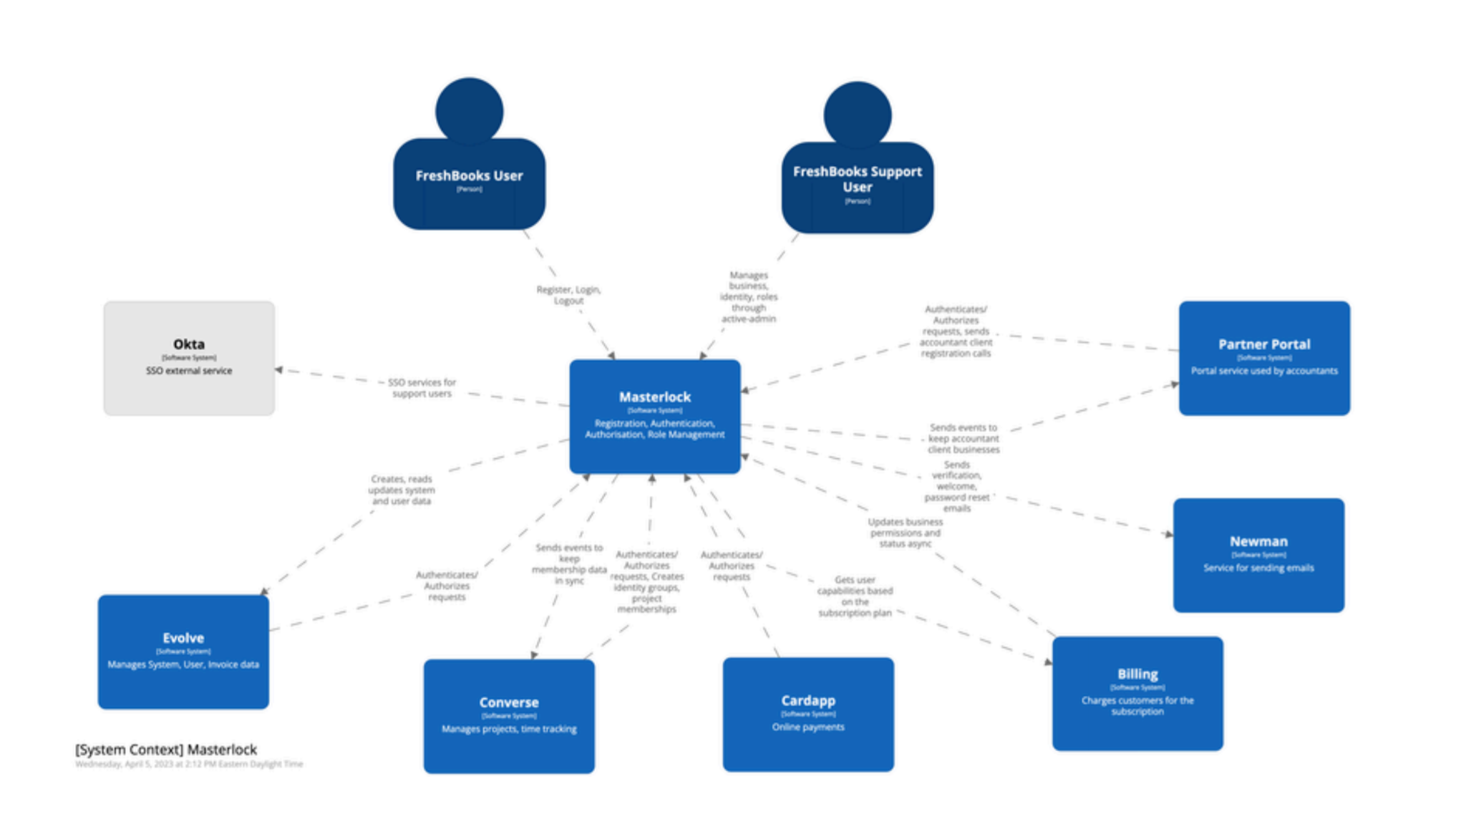
Tech Stack @ FreshBooks
]
Notes:
Before we start getting deeper, I wanted to quickly paint you a picture of how Authorization worked at FBs. Now, I know the picture is slightly blurry here. The main thing to note is that all systems are pointing to the system in the middle called MasterLock MasterLock is FB’s Core AuthN + AuthZ System.

Slide 37
Tech Stack @ FreshBooks
]
Everything depends on Masterlock
Notes:
So you can imagine, everything depended on Masterlock
Let’s look at an example of the 1 of the 933 places I had to check

Slide 38
Tech Stack @ FreshBooks
]
Express.js, React - UI
Python - Backend
Ruby on Rails - AuthN + AuthZ
Notes:
Since we’re voyeurs when it comes to Tech Stack, let me indulge you with what FreshBooks was like

Slide 39
Masterlock - Center of it all
]
Masterlock - Ruby on Rails, Devise (AuthN), Pundit (AuthZ)
50ms is expected norm for AuthZ calls
Increase of DataDog Threshold from 250ms -> 600ms
-> AuthZ Calls were taking up to 600ms
Notes:
DataDog Joke : I originally used the word Budget instead of Threshold and I evoked PTSD for people who got stung by their bill increase couple of years ago.

Slide 40
Masterlock - Center of it all
]
Masterlock - Ruby on Rails, Devise (AuthN), Pundit (AuthZ)
50ms is expected norm for AuthZ calls
Increase of DataDog Threshold from 250ms -> 600ms
-> AuthZ Calls were taking up to 600ms
Increased AuthZ calls impacting UX negatively
Decentralised Mess -> Role Data with MasterLock (Pundit), Role Logic stored with each Application
Notes:
So you had Data that was stored centrally, but logic was distributed, which isn’t necessarily bad, but in my case it was

Slide 41
Typical Code for checking permissions
Typical API Endpoint Call: def put(self, business_uuid):
if not self.permission.can_update():
raise ForbiddenError
# ... do some updates ...
Typical Authorization Check:
class <BusinessUnit>Permission(BasePermission):
def can_read(self):
return self.role in [
self.BUSINESS_OWNER_ROLE,
self.BUSINESS_PARTNER_ROLE,
self.ACCOUNTANT_PARTNER_ROLE,
]
def can_update(self):
return self.role in [
self.BUSINESS_OWNER_ROLE,
self.BUSINESS_PARTNER_ROLE,
self.ACCOUNTANT_PARTNER_ROLE,
]
Notes:
So let’s look at an example of the 1 of the 933 places I had to check. This is a Rest API Call checking for Permissions. You can see the Permissions seem to be embedding with the code or the business object here

Slide 42
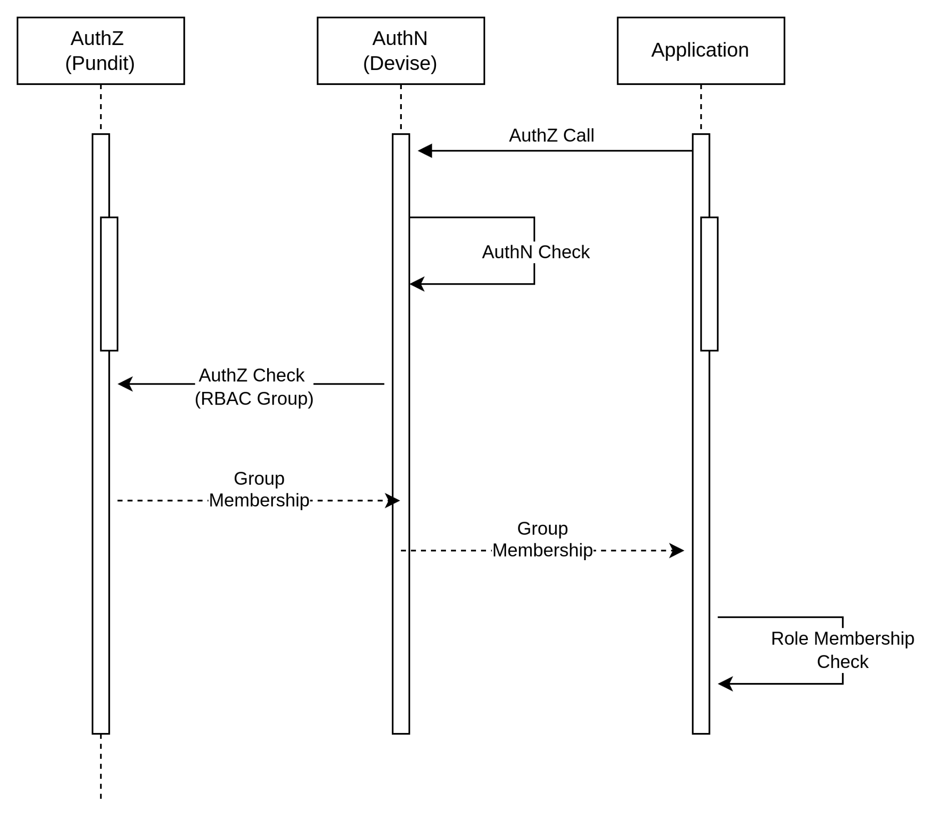
An AuthZ Call @ FreshBooks
Notes:
Key things to note is that we have 3 places and multipel calls doing the whole AuthN + AuthZ sequence. This sequence is taking up to 600ms

Slide 43
Role Based Access Control (RBAC)
def put(self, business_uuid):
if not self.permission.can_update():
raise ForbiddenError
# ... do some updates ...
class <BusinessUnit>Permission(BasePermission):
def can_read(self):
return self.role in [
self.BUSINESS_OWNER_ROLE,
self.BUSINESS_PARTNER_ROLE,
self.ACCOUNTANT_PARTNER_ROLE,
]
def can_update(self):
return self.role in [
self.BUSINESS_OWNER_ROLE,
self.BUSINESS_PARTNER_ROLE,
self.ACCOUNTANT_PARTNER_ROLE,
]
Role Based Security
Role based Access Control
(RBAC)
Notes:
Everyone has seen this type of code before right? Imagine changing / analysing 933 instances of code like this throughout your entire SAAS application

Slide 44
Pros & Cons with RBAC (Role based)
Pros
Simple
Easy to implement
Great for small/medium apps
Well defined Permission Set that doesn’t change

Slide 45
Pros & Cons with RBAC (Role based)
Pros
Simple
Easy to implement
Great for small/medium apps
Well defined Permission Set that doesn’t change
Cons
Not Scalable for Enterprise / SAAS
Difficult to change or introduce new permissions (Role Explosion)
Simple, Low Granular Permissions
Tight Coupling

Slide 46
Are there Alternatives out there?
Notes:
Just filled my Cat meme Quota. Check.

Slide 47
Attribute Based Access Control (ABAC)
In a Nutshell : -
Method of doing Access Control over attributes across 4 areas using policies
Subject (User)
Resource
Action
Environment
Notes:
So during my research, I can across something called ABAC.

Slide 48
Attribute Based Access Control (ABAC)
In a Nutshell : -
Method of doing Access Control over attributes across 4 areas using policies
Subject (User)
Resource
Action
Environment
Notes:
So during my research, I can across something called ABAC.

Slide 49
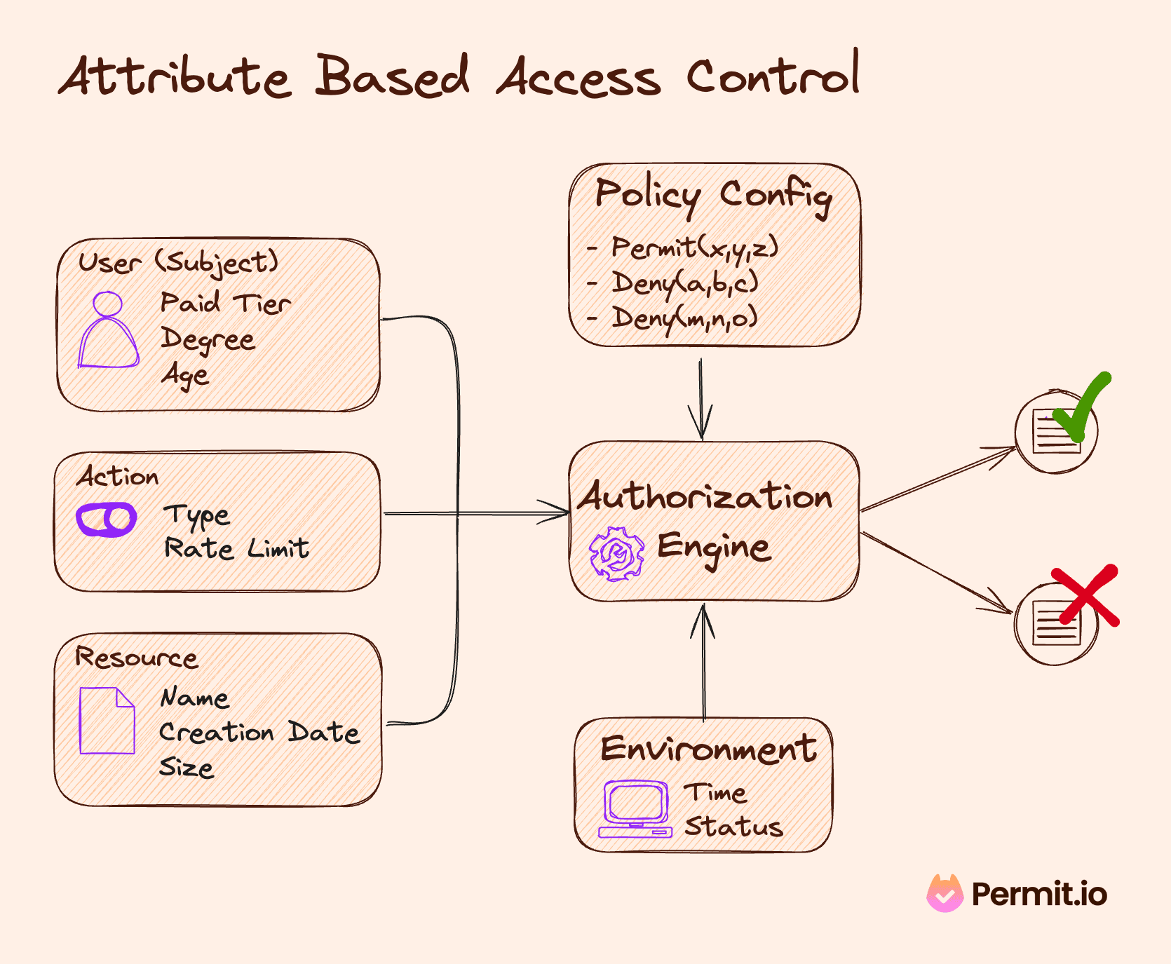

Slide 50

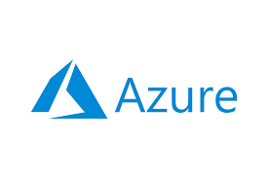

Notes:
Cloud Providers provide ABAC to protect your cloud resources and infrastructure online

Slide 51
Attribute Based Access Control (ABAC)
Pros
Granular / Flexible Permissions
Scalable - If done right
Better Security + Compliance
Centralised
Cloud Providers

Slide 52
Attribute Based Access Control (ABAC)
Pros
Granular / Flexible Permissions
Scalable - If done right
Better Security + Compliance
Centralised
Cloud Providers
Cons
Complex!
Performance - Latency
Harder to Audit
XACML - Extensible Access Control Markup Language
Notes:
XACML seems to be standard way of doing ABAC

Slide 53
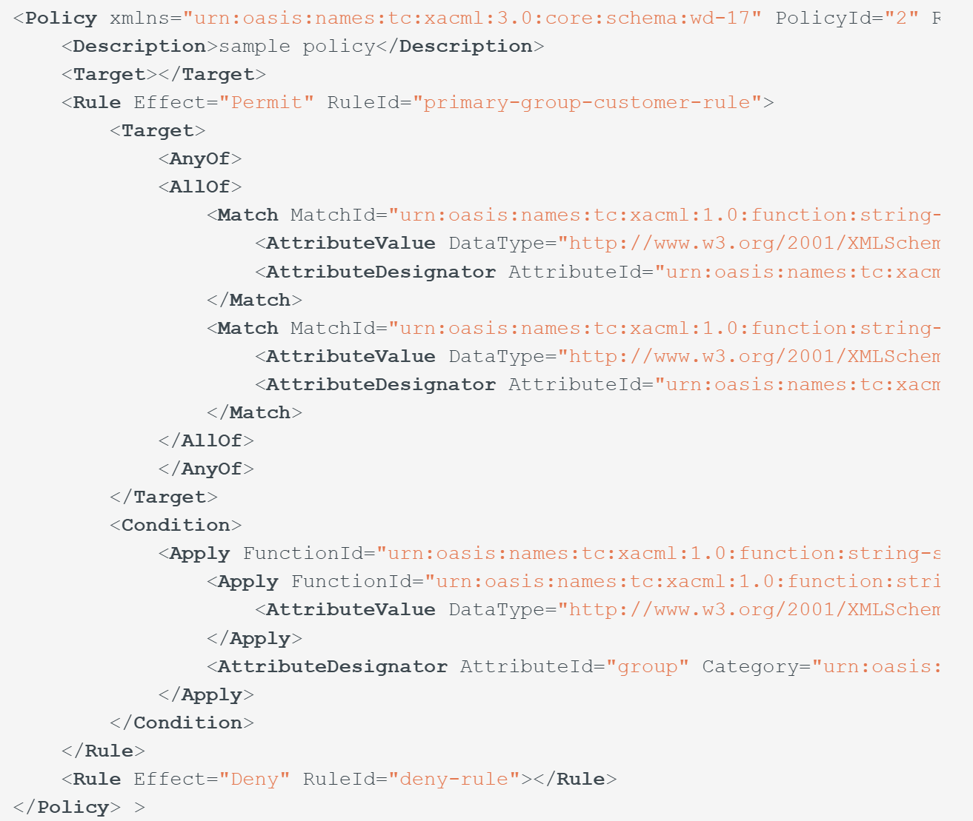
ABAC - XACML Example
Notes:
People love XML so much, you have American Developers quoting quotes like “XML is like violence: if it doesn’t solve your problem, you aren’t using enough of it.” - Chris R Maden, American Data Analyst & Programmer

Slide 54
Notes:
So I came to the same conclusion as The Mandalorian (or Mando as I affectionately call him)

Slide 55
Google Zanzibar
Notes:
Then I came across something called Google Zanzibar. ….. And you might be thinking …

Slide 56
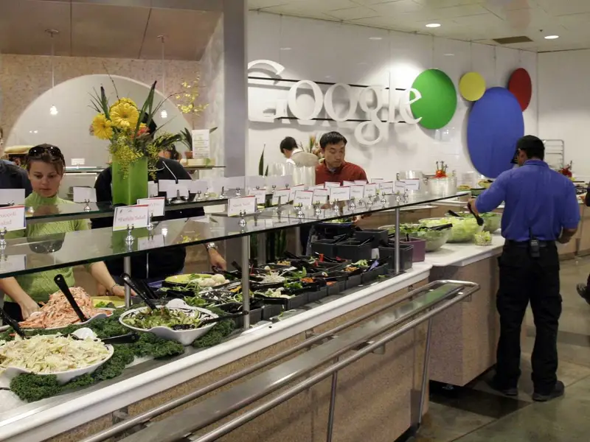
Google Zanzibar
Notes:
… is it their famous Salad bar in their staff restaurants? No it isn;t …. But have a look at this impressive salad bar anyways

Slide 57
Google Zanzibar
Access Control System for all of Google’s Services (Internal + External)
Calendar, Cloud, Drive, Maps, Photos, and YouTube etc

Slide 58
Google Zanzibar
Access Control System for all of Google’s Services (Internal + External)
Calendar, Cloud, Drive, Maps, Photos, and YouTube etc
95th-percentile latency of less than 10 milliseconds
Availability of 99.999% over 3 years (Five 9s)
Notes:
50ms is considered a good time for an Authorisation call. In FBs, we had to increase our DataDog latency budget from 250ms to 600ms.

Slide 59
Google Zanzibar
Access Control System for all of Google’s Services (Internal + External)
Calendar, Cloud, Drive, Maps, Photos, and YouTube etc
95th-percentile latency of less than 10 milliseconds
Availability of 99.999% over 3 years (Five 9s)
2 trillion relational tuples that occupy close to 100 terabytes
> 10 million client queries per second (QPS)
10,000 servers organized in several dozen clusters
Planetscale Numbers!
Notes:
50ms is considered a good time for an Authorisation call. In FBs, we had to increase our DataDog latency budget from 250ms to 600ms. Now you need to be wary, when you see the word PlanetScale bandied about

Slide 60
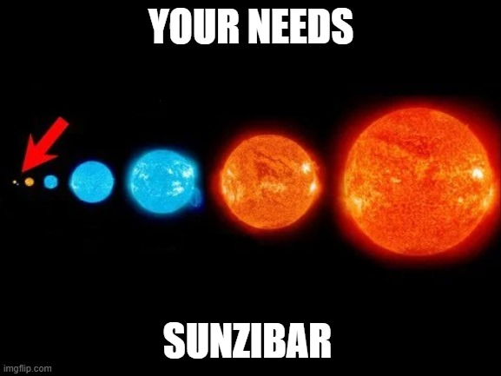
Notes:
Now, you Should be very wary when someone mentions PlanetScale, because this is what it usually means. We’ve already been scarred by Kubernetes and Microservices right? I am amazed Google and Netflix doesn’t get more hate from the community.

Slide 61

Google Zanzibar
Relationship based Access Control (ReBAC)
Notes:
In my earlier slide, I mentioned 2 trillion relation tuples, so that was a hint of what Zanzibar uses underneath

Slide 62

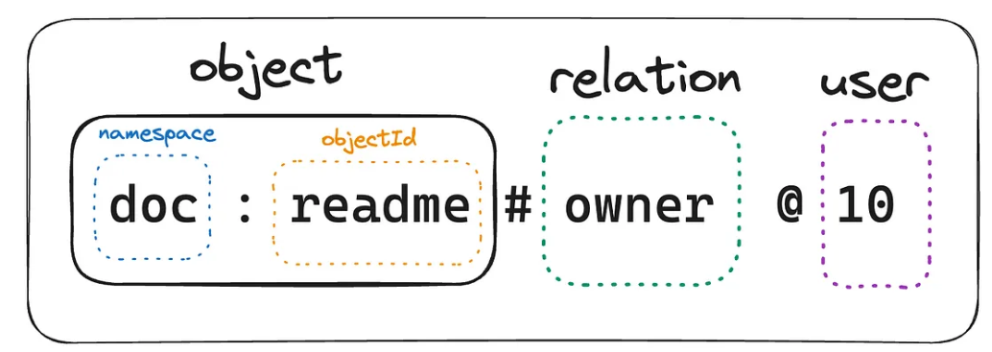
Google Zanzibar - Relational Tuples
Notes:
Relation Tuples are just sequence of values that denotes a relation between an object and a user

Slide 63
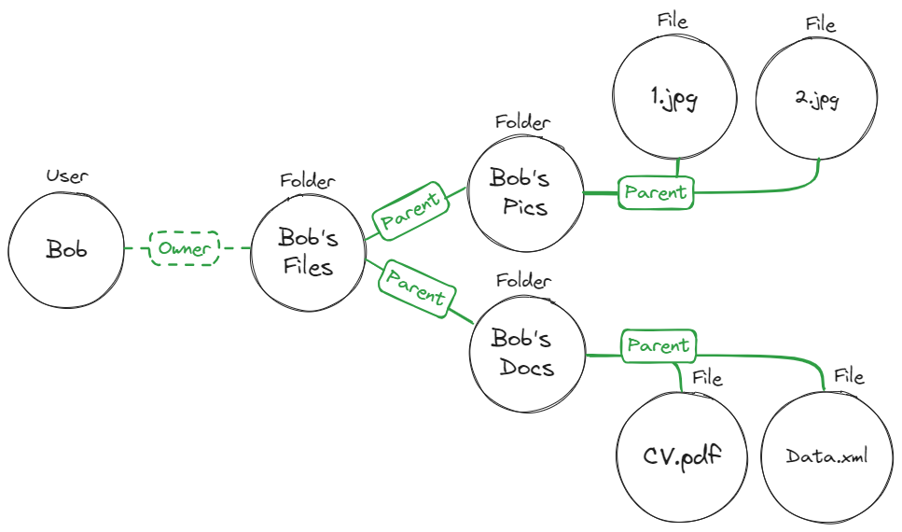

Relationship Based Access Control (ReBAC)
Notes:
At the heart of ReBAC, as the name implies is describing relationships between 2 entities as a tuple or a graph (which is a good way of mapping relationships). So you’re not just mapping users but whatever entity you like such as objects, resources etc

Slide 64
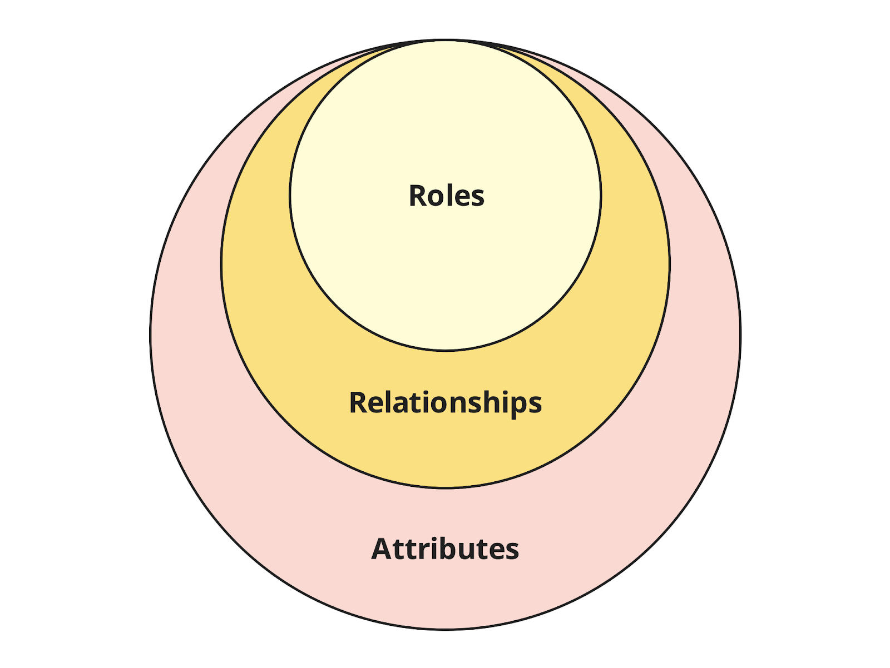

RBAC vs ABAC vs ReBAC - Concepts
Notes:
We can take a step back and look at it from a conceptual viewpoint. So Attributes > Relationships > Roles. If you’re thinking about moving from RBAC to ReBAC, the above graph tells you that a natural migration path exists

Slide 65
Relationship based Access Control (ReBAC)
Pros
Granular / Flexible Permissions
Scalable
Visual | Graphical
Centralised

Slide 66
Relationship based Access Control (ReBAC)
Pros
Granular / Flexible Permissions
Scalable
Visual | Graphical
Centralised
Cons
Relations can be complex to map
Learning curve - Graph Theory
Not as granular as ABAC
Auditing - Could be challenging
Major Cloud Providers not offering
Notes:
XACML seems to be standard way of doing ABAC

Slide 67
Google Zanzibar Solutions
Open Source
SpiceDB
OpenFGA
Ory / Keto
Permify
Permit.io
Topaz
Commercial
Oso
Auth0 / Okta (OpenFGA)
Notes:
Google Zanzibar is not open source, but they did release a white paper on it. So plenty of people rushed off to build their interpretations of it when the white paper was published

Slide 68
Google Zanzibar Solutions
Open Source
SpiceDB
OpenFGA
Ory / Keto
Permify
Permit.io
Topaz
Commercial
Oso
Auth0 / Okta (OpenFGA)
Notes:
I’ll be doing a quick demo showcasing ReBAC concepts in Topaz, and the reason I’ve picked Topaz is for several reasons.

Slide 69

Topaz
Open Source
Supports Open Policy Agent (OPA) and Zanzibar
Supports RBAC, ABAC and ReBAC
OPA -> Policies are expressed as code
Topaz’s Policies -> Json like DSL
Notes:
Open Policy Agent is an Cloud Native Computing Foundation Project that provides a way of declaratively (DEE-CLARE-RATIVELY) writing policies as code (think Terraform for Policies)

Slide 70
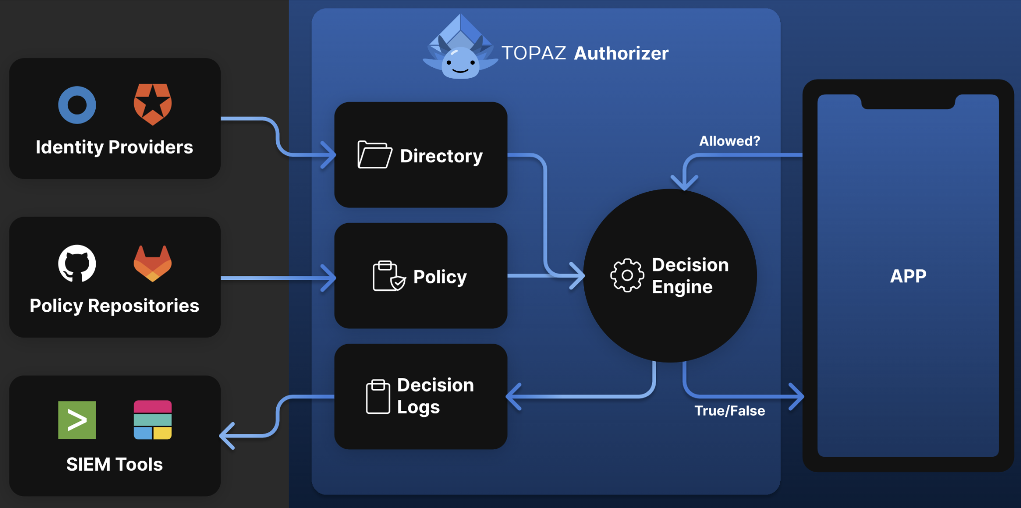
Topaz Architecture
Notes:
It’s similar to the ABAC diagram I showed earlier, but much simpler.
ID Providers does the Auth part (and you can connect external ones) Policy Repos are your data stores of your policies SIEM - Security Information and Event Managment - Real-time visibility across an organization's information security systems

Slide 71
Topaz - RBAC Policy Example
allowed {
ds.check({
"object_type": "tenant",
"object_id": input.resource.tenant_id,
"relation": "viewer",
"subject_type": "user",
"subject_id": input.user.id,
})
}
Notes:
It’s using json, not violent XML as you can see. And this code sample is an example authorization check to see if the Subject is able to view Tenant’s detail by checking to see if it’s in the viewer membership

Slide 72
Topaz - ReBAC Policy Example
allowed {
ds.check({
"object_type": "document",
"object_id": input.resource.doc_id,
"relation": "can_read",
"subject_type": "user",
"subject_id": input.user.id,
})
}
Notes:
This check is to see if the user has a “can_read” relationship defined against this particular document

Slide 73
Topaz - RBAC & ReBAC
allowed {
ds.check({
"object_type": "tenant",
"object_id": input.resource.tenant_id,
"relation": "viewer",
"subject_type": "user",
"subject_id": input.user.id,
})
}
allowed {
ds.check({
"object_type": "document",
"object_id": input.resource.doc_id,
"relation": "can_read",
"subject_type": "user",
"subject_id": input.user.id,
})
}
Notes:
This check is to see if the user has a “can_read” relationship defined against this particular document

Slide 74
Topaz - ABAC Policy Example
allowed {
ns := time.now_ns()
day := time.weekday(ns)
day == data.workdays[_]
input.user.properties.department == "Sales"
}
Notes:
This is basically a policy to check if the person being checked is working in Sales and during working hours

Slide 75
Topaz - ASP.NET Core Example
//Startup.cs
using Aserto.AspNetCore.Middleware.Extensions;
using Aserto.AspNetCore.Middleware.Policies;
// ...
//Aserto options handling
services.AddAsertoAuthorization(options => Configuration.GetSection("Aserto").Bind(options));
//end Aserto options handling
services.AddAuthorization(options =>
{
options.AddPolicy("Aserto", policy => policy.Requirements.Add(new AsertoDecisionRequirement()));
});
// ...
app.UseAuthorization();
//<Some>Controller.cs
[ApiController]
[Route("/todos")]
public class GetTodosController : ControllerBase
{
//...Some code
[HttpGet]
[Authorize("Aserto")]
public async Task<IEnumerable<TodoResource>> GetAllAsync()
{
var todos = await _todoService.ListAsync();
var resources = _mapper.Map<IEnumerable<Todo>, IEnumerable<TodoResource>>(todos);
return resources;
}
}
Notes:
So it’s pretty simple with ASP.NET - 4 lines of code to Startup.CS
And 1 Attribute per API Endpoint You’re just referencing Aserto’s libraries at the top. You’re asking to add their Authorization Capabiltiies to ASP.NET Core
And you’re asking it to use their Policies And at the endpoint, you’re asking it to use Aserto to to check for Authorization to call the endpoint and that’s it

Slide 76
RBAC, ReBAC and ABAC - Which Path?
Notes:
We can take a step back and look at it from a conceptual viewpoint. So Attributes > Relationships > Roles. If you’re thinking about moving from RBAC to ReBAC, the above graph tells you that a natural migration path exists

Slide 77
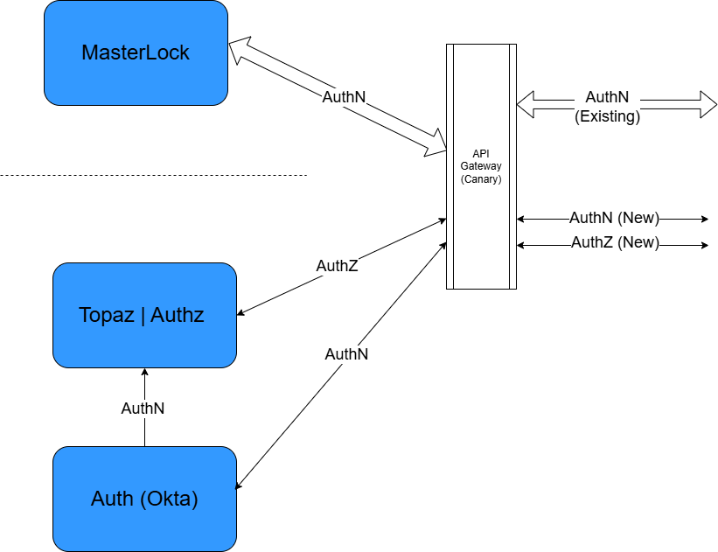
FreshBooks - A Vision Unfulfilled
Notes:
So, I want to go back to my FreshBooks example and in particular, to my vision of eventually Masterlock and improving its AuthZ speed

Slide 78
Access Control Models - Out of Scope
Policy Based Access Control (PBAC)
Access Control List (ACL)
Discretionary Access Control (DAC)
Notes:
So during my research, I can across something called ABAC.

Slide 79



Acknowledgements
Ben Robinson (aka The Intern) -
Now a FullStack Ruby/TS/Python Developer
Chris Simon - DDD-AU
George Jayaratnam - Quant Risk Management, Data Engineering

Slide 80
The End
There are solutions out there. No need to jump out of buildings!
Notes:
No matter how mission impossible a situation might be, there are always solutions out there.

Slide 81
Q & A
If I didn’t answer your question,
please send me a message on LinkedIn
https://www.linkedin.com/in/francischung/

Slide 82
References
https://www.permit.io/blog/what-is-abac
https://www.permit.io/blog/what-is-rebac
https://permify.co/post/relationship-based-access-control-rebac/
https://www.osohq.com/academy/relationship-based-access-control-rebac
https://www.descope.com/learn/post/rebac
https://zanzibar.tech/2Dy8fNih7E:m:1Y
https://authzed.com/blog/what-is-google-zanzibar
https://workos.com/blog/what-is-rebac-relationship-based-access-control
https://www.permit.io/blog/conditions-vs-relationships-choosing-between-abac-and-rebac
https://www.descope.com/blog/post/rbac-vs-rebac
https://www.aserto.com/blog/abac-vs-rebac-fine-grained-access-control
https://www.youtube.com/watch?v=oW4QRTke-Oc
https://www.youtube.com/watch?v=qn6c-XNLdqw
https://www.strongdm.com/blog/rbac-vs-abac

Slide 84
RBAC (Role based) - Pros Revisited
Pros
Simple
Easy to implement
Great for small/medium apps
Well defined Permission Set that doesn’t change
Notes:
So I want to re-emphasise that if your use case lies within the blue points above, you should probably stick to RBAC. But it also doesn’t mean something like Zanzibar might not be for you either.

